Slide 1
ASPIRE TRAINING
Study Product
Considerations & Accountability for Non-Pharmacy Staff
Notes:
Training Binder Section = Study Product
Objectives:
Understanding product returns and study product accountability tracking procedures
Understand the used ring collection and destruction practices that take place in the clinic
Understanding the product resupply process at follow-up
Include minimum required procedures to dispense study product in the event of a missed/split visit
Understand the options available for resupplying product; particularly in the event of a visit that is late in the visit window, split visits, and missed visits.
Understand the procedures for product holds/discontinuations/retrievals documentation. This will include return of used ring for destruction or to lab or unused back to pharmacy.

Slide 2
Study Product Management Documentation on CRFs:
Ring Collection/Insertion
Product Hold/Discontinuation Log
Training Binder page 327

Slide 3
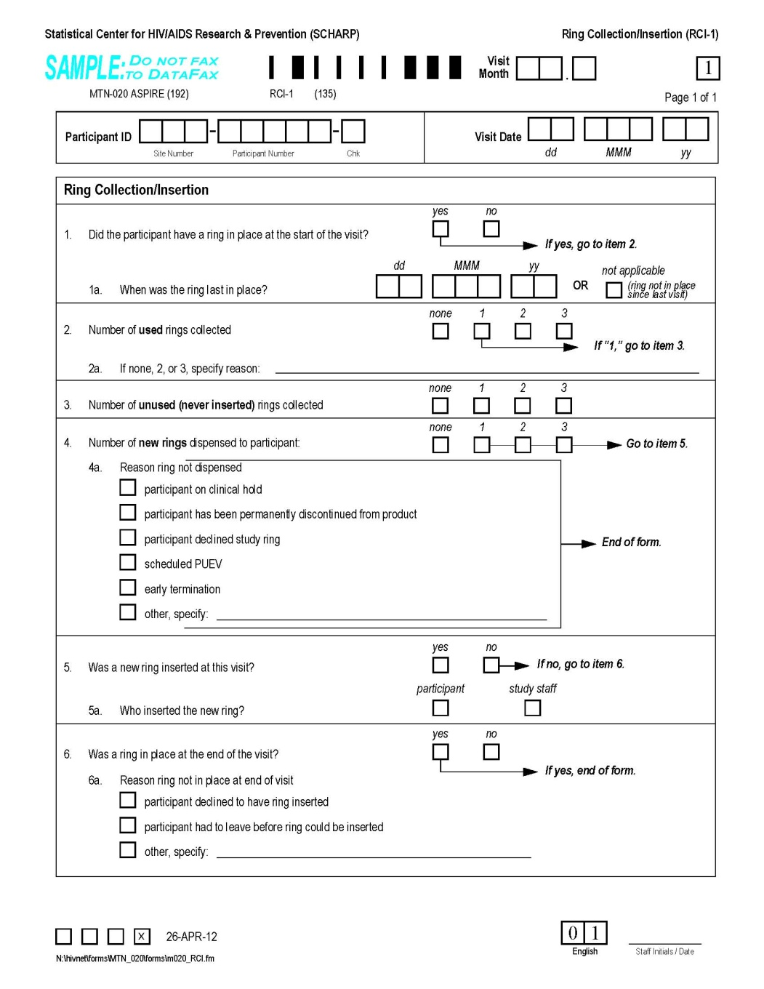
Page 327
Ring Collection/Insertion CRF (RCI-1)

Slide 4
Ring Collection/Insertion CRF (RCI-1)
Complete at each required follow-up visit, even if ppt has been on product hold
Complete at other (interim) visits whenever a new ring is given or a ring is collected (used or unused)
Item 1: was ring in place at start of visit? If not, date last in place or “not applicable – ring not in place since last visit”
Item 2: # used (inserted) rings collected
  If not 1, asked to provide reason
Item 3: # unused (not inserted) rings collected
Item 4: # new rings dispensed
  If none, mark reason why and end the form
  New specify line - If ppt declined study ring → provide reason she gave for not wanting a new ring

Slide 5
Ring Collection/Insertion CRF - continued
Item 5 – was a new ring inserted at the visit, and if yes, who inserted the ring
Item 6 – was a ring in place at the end of the visit
  If not, reason why
Form will tell us who if the ppt came in with a ring in place, left with a ring in place, and if not, reason why

Slide 6
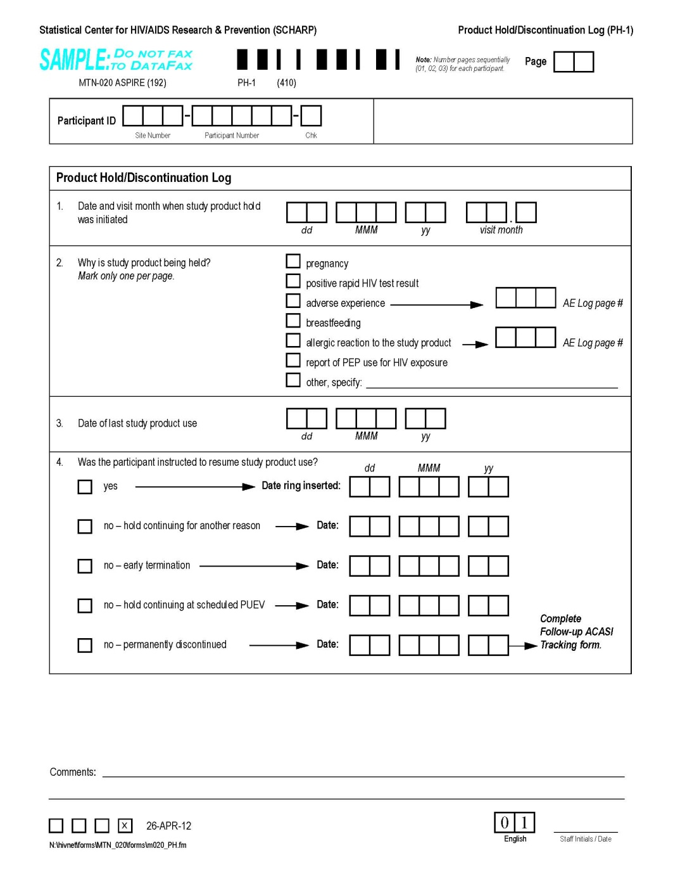
Product Hold/Discontinuation Log CRF (PH-1)
Page 325

Slide 7
Product Hold/Discontinuation Log CRF (PH-1)
All product holds and permanent discontinuations initiated by study staff are documented using the PH Log CRF
Complete each time and for each reason a hold or perm d/c is required
  1 PH Log CRF per reason, even if multiple reasons for hold at a given visit
  Complete even if ppt is already on hold (ex. A pregnant ppt has a genital finding requiring a hold)
  CRF updated and re-faxed once it is determined whether product use will be resumed or not
Not completed in cases of ppt decline
  documented on VR Request Slip, RCI-1

Slide 8
Product Hold/Discontinuation Log CRF, cont’d
Number PH Log CRF pages sequentially for each ppt starting with 01
Item 1 – date and visit month at which clinic staff initiated the hold; should match up with item 7 of Visit Summary CRF completed for the visit
  Visit Month/Code may be an interim visit code
Item 2 – reason for the hold
  Mark only one reason per CRF page

Slide 9
Product Hold/Discontinuation Log CRF, cont’d
Item 3 – date vaginal ring was last in place
  Can be per ppt report
  Use best estimate if exact day is not known
Unless it is known that this is a permanent discontinuation, go ahead and fax the form at this time (leave item 4 blank)
  May also fax in with item 3 blank if needed (hold initiated but cannot obtain date ring last in place)
Once staff have determined if product use will be resumed or not, complete item 4, initial and date, and re-fax

Slide 10
Product Hold/Discontinuation Log CRF, cont’d
Item 4 – lots of options, each with a date
  “yes” if ppt will resume product use
  “no – hold continuing for another reason” if ppt would resume product use based on the reason marked in item 2, but is continuing on product hold for another reason (documented on a separate PH Log CRF)
    Record date use would have resumed
  “no – early termination” if ppt terminates early and the hold was ongoing at time of early termination
    Record date of early termination

Slide 11
Product Hold/Discontinuation Log CRF, con’t
Item 4 – continued
  “no – hold continuing at scheduled PUEV” if hold ongoing when ppt completes her scheduled PUEV
    Record PUEV date
  “no – permanently discontinued” if ppt was permanently discontinued prior to PUEV/early termination
    Record date it was determined by study staff the ppt would be permanently discontinued from study product

Slide 12
Clinic Study Product Accountability
Product Accountability by Clinic Staff
Documentation of Product Requests, Dispensations, and Returns during follow-up
Product Retrieval
Other Study Product Considerations

Slide 13
Study Product Accountability- Clinic
For each dispensed ring, clinic accountability starts once a ring is dispensed from pharmacy (to the staff member)
Clinic accountability responsibility ends when:
1. The used (inserted) ring is sent to the laboratory
for storage
2. The used (inserted) ring is sent for destruction
3. The UNUSED (not inserted) ring is returned to the
pharmacy for quarantine
4. Documentation of 1, 2, or 3 is completed
Notes:
The clinic is responsible for documenting the final fate of the ring. This is either sent to the lab, placed in a container for destruction, or if unused, sent to the pharmacy for quarantine. Regardless, the final step must be documented on the Clinic Study Product Accountability Log.

Slide 14
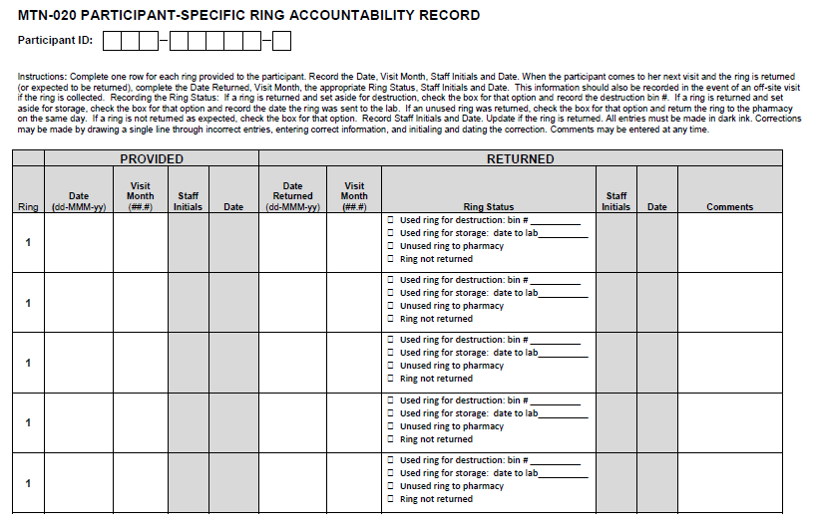
MTN-020 Clinic Study Product Accountability Log
Notes:
This log must remain in the clinic and is used to document providing a ring to the participant as well as the return of that ring.
Focusing on the return portion of the log, the first step is to complete the RETURNED section of the Clinic Accountability log. The information the must be completed includes the date the ring is returned/removed, visit code, # rings returned to the pharmacy if UNUSED, # used rings returned, # used rings stored for lab, date the ring sent to lab, # rings placed in destruction container and the container code. In order to complete the product destruction container code, sites will need to determine (in their SOP) how they want to code the containers. The used rings will need to be place in a container that will be destroyed. The final columns include clinic staff initials and a place for comments if applicable.
This log can be modified to be site specific, must contain the key information and be reviewed by MTN regulatory before implementing use.

Slide 15
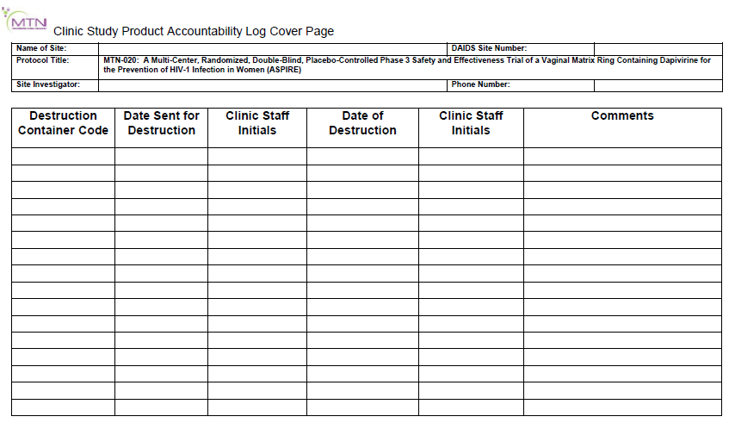
MTN-020 Clinic Study Product Accountability Log Cover Page
Notes:
This is the Clinic Study Product Accountability Log Cover page. This page is completed whenever a destruction container is destroyed in the manner outlined n the sites SOP. At that time the destruction Container Code is recorded with the date of destruction, any relevant comments and staff initials. The site should receive a document verify the destruction of the container which should be placed in the sites ASPIRE regulatory file.

Slide 16
Study Product During Follow-Up –
Vaginal Ring Request Slip
Used by Clinic to communicate to Pharmacy study product needs for each ppt
Like with the prescription, a 2-part NCR form:
Be sure all signatures and initials are complete.
Retain the yellow (clinic) copy in the participant study notebook.
Deliver the white (pharmacy) original prescription to the study pharmacy.
The pharmacist will review the request slip for completion and accuracy.
Notes:
Page 321 in the binders

Slide 17
MTN-020 VAGINAL RING REQUEST SLIP
Page 321
Notes:
This is what the entire form looks like but the next few slides will focus on specific sections.
This request slip is in the study product section of the binder- page 321.

Slide 18
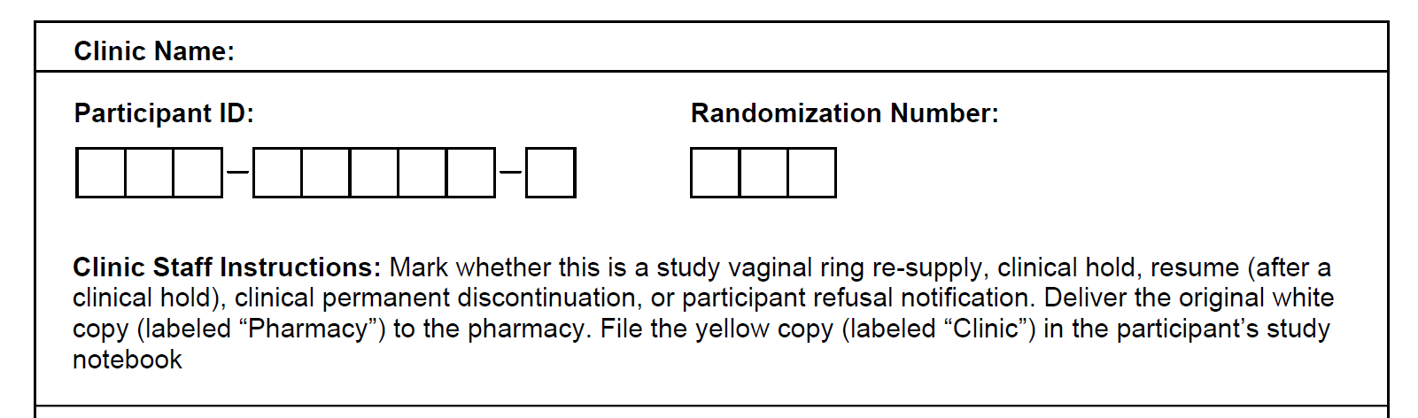
MTN-020 Vaginal Ring Request Slip
Supplied by SCHARP
At top, record clinic name, PTID and randomization number

Slide 19
MTN-020 Vaginal Ring Request Slip
Middle portion – mark one box to indicate action requested by Pharmacy
  Re-supply for typical dispensations
  Hold for temporary clinic staff initiated holds
  Resume for 1st dispensation after a hold
  Participant decline if ppt refuses new ring
  Permanent discontinuation for clinic staff initiated permanent discontinuations (HIV-infected)
  Ppt no longer in study - ppt’s Termination/early term visit
Bottom portion – printed name, signature, date

Slide 20
MTN-020 Vaginal Ring Request Slip – con’t
If ppt is on hold for consecutive months, or on hold for multiple reasons, only one slip is needed
  Do not need to complete a “hold” slip each month if hold is continuing, even if a new reason for hold occurs
  Just complete “resume” one ppt no longer on hold
If slip completed for “permanent discontinuation”, no further slips needed
If “ppt decline”, do complete a slip each month (each time) the ppt refuses to accept a new ring

Slide 21
MTN-020 Vaginal Ring Request Slip -
Error Corrections Once Form is Separated
In the event that pharmacy staff identifies possible errors on the original (top, white) prescription, they will return the original prescription to clinic staff for clarification or correction.
If corrections are required, they must be made SEPARATELY on both the white original request slip and the yellow copy.

Slide 22
Vaginal Ring Use Duration Guidelines

Slide 23

Vaginal Ring Use Duration
Typically worn for about 4 weeks (28 days)
Per protocol, it is recommended that ring use not exceed 35 days
If prolonged use (>35 days) occurs, attempt should be made to contact the participant, retrieve the used VR, and supply a new VR
Notes:
Typical Use: The ring is designed to be worn for about 4 weeks consecutively, replaced at each study follow-up visit. With regular visit attendance, this will be the typical use pattern for participants. Occasionally, participants may not make their target visit date, or they may miss a visit – so lets spend some time discussing ring use in these situations.
Participants should be counseled to refrain from removing the ring until the next scheduled visit (approximately 28 days). The ring should be replaced after 35 days. This guidance is due to concerns of adequate drug concentration and is not based on safety concerns. Sites must consider this when developing visit scheduling and tracking systems.

Slide 24
Minimum Procedures for VR dispensation:
AE assessment and reporting (verbal report of symptoms is acceptable; if symptoms indicate that further evaluation is necessary, this must be conducted prior to dispensing study product)
HIV testing and counseling (including RR counseling) and pregnancy testing are required for product dispensation if this has not been done at the research clinic within the past 60 days (i.e. within last 2 scheduled visits)
Collection of Used Ring (and unused, if applicable), if available
Adherence Counseling/Product Use Instructions, as needed
Notes:
While conducting all visit procedures for each scheduled visit is ideal, it is acknowledged that this might not always be possible. At a minimum, all of the following procedures must be conducted in order to dispense study product.
Highlight rationale during these next few slides = Priority is Ring Coverage/Providing the opportunity for high adherence
Knowing this set of minimal procedures is important for understanding options for ring provision at interim visits, split visits, or off-site visits to deliver a ring. Highlight the rationale behind the pregnancy/HIV testing being within 60 days, and how this is based in the allowance that per the IoR discretion they can provide up to one additional ring (2 with MO approval).

Slide 25
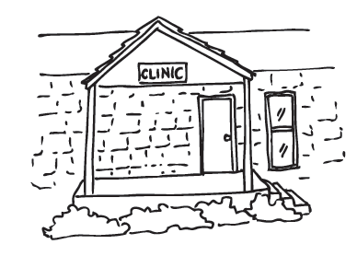
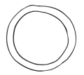

Equivalent Timeframes
[Missed Visit]
Dispense 2 Rings
Next In-Clinic Visit
Approximately 60 Days
Dispense 1 Ring
Deliver 1 ring off-site
Next In-Clinic Visit
Notes:
Per protocol section 6.4.2 the IoR may dispense an additional ring (in other words, 2 total rings) if the participant is unable to attend her next scheduled visit.
This slide illustrates how dispensing 2 rings in advance is equivalent to delivering her an additional ring off-site between visits. This is the rationale as to why the safety testing is not required for ring delivery/dispensation if it has been completed within 60 days time.

Slide 26
Provision of >2 VRs
Requires consultation/approval by DAIDs MO
Contact information (email/phone) and further details about process in SSP
Print/File email communication or written summarily of phone call approving the request

Slide 27
Visit Windows and
Product Use Duration
Options for Product Coverage?
35 Days
Visit Window = 28 Days
Visit
Target Date
-13 Days
+14 Days
Notes:
Target Visit Window = 28 days
Typical Ring Use Duration = 28 days
Visits should be scheduled every 28 days to the extent possible. If the next possible visit date is more than a week after this 28 day target date, one of the following options should be pursued to ensure appropriate ring coverage between visits: (next slide)

Slide 28
Options for Re-Supplying Product
If the participant will be late in the visit window:
Determine whether a second ring could be provided per IoR Discretion, OR
Determine whether an off-site visit could be conducted to provide the participant with a new VR at or before Day 35
If none of the options above can be pursued (only in rare instances), schedule the participant to come in to the clinic for her visit as soon as possible for her follow up visit.
It is also an option to schedule the participant to come back before the target date if still in the visit window.

Slide 29
The visit is incomplete and the participant can’t stay… what to do with the study product?

Slide 30
VR Considerations When All Required Procedures Not Done on 1 Day
If possible, complete minimum procedures required for product dispensation on the first day of the split visit
If safety testing cannot be completed, what are options for ensuring ring coverage?
Notes:
In cases where follow-up visit procedures are split across more than one day, every effort should be made to complete HIV testing, pregnancy testing, all other safety evaluations required for product dispensation (as listed in Section 9.6), and product dispensation on the first day of the split visit. If safety testing cannot be performed, the IoR or designee should determine if a new ring should be provided to the participant at that visit.

Slide 31
If safety testing cannot be completed during first part of split visit:
Leave current VR in place, OR
If safety testing has been done at previous visit, the IoR/Designee may decide to supply new VR at their discretion
If the safety testing cannot be done, and has not been done at the previous visit, she may need to leave without a VR (if current is nearing 35 days of use).
  Effort should be made to bring participant in to complete the split visit ASAP, or other options for ensuring ring coverage should be pursued (i.e. conduct safety testing and resupply of VR at an off-site visit)
Notes:
Leave current VR in place. Depending on when she can return to complete the visit and how long her current ring has been in place, the IoR/designee may decide the best option is to leave current VR in place until the time she can return.
If safety testing has been done at previous visit, the IoR/Designee may decide to supply new VR at their discretion (highlight allowance in the protocol to supply up to one extra VR, and how this is no different than if she had anticipated a “planned missed visit” at her previous visit).
If the safety testing cannot be done, and has not been done at the previous visit, she may need to leave without a VR (if current is nearing 35 days of use). In these cases, effort should be made to bring participant in to complete the split visit ASAP, or other options for ensuring ring coverage should be pursued (i.e. conduct safety testing and resupply of VR at an off-site visit)

Slide 32
VR Considerations –
Missed Visits
Assess current duration of VR use and determine next steps, which may include:
  Reschedule, leaving current VR in place
  Supply new VR at interim visit in clinic (+/- safety tests)
  Delivery of new VR off-site (+/- safety tests)
Notes:
If a scheduled visit is missed, staff members should assess the amount of time that has passed since the participant was last dispensed a VR and whether she has an extra VR at home or not. The IoR or designee should determine next steps.
+/- Safety testing → must be provided prior to VR dispensation unless the criteria outlined previously apply (had in last 60 days).
Note: If a VR is provided at an interim visit (either off-site or in-clinic), a new ring should still be provided at her next regularly scheduled clinic visit to ensure that the amount of time the VR can be used for is still on schedule with her regular clinic visit schedule.

Slide 33
Study Product Scenarios
Instructions:
Review each scenario and the questions posed by each scenario
Talk through answers with group/Group Leader
Any questions teams have can be asked at the end of the breakout

